Slide 1
Let’s ‘Git’ the world …
مروری بر نحوه کار با Git

Slide 2

پیشکشی به برنامه‌نویسان علاقه‌مند ...
کاری مشترک از عماد آقاجانی [1] و حسین رحمتی زاده [2]
[1],[2]

Slide 3
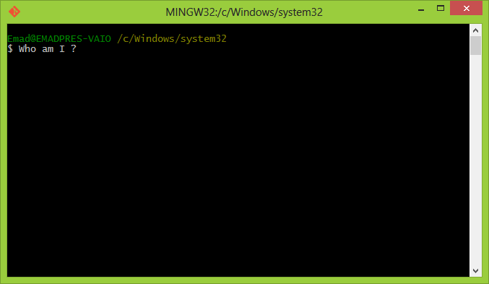
Hello guys !
My name is Git ...
A Version Control System (VCS)
Distributed design
Written to manage the linux kernel (big files)
Designed for speed
Snapshot base ( not file base )
Git for Backups
  Need more ? /:)

Slide 4
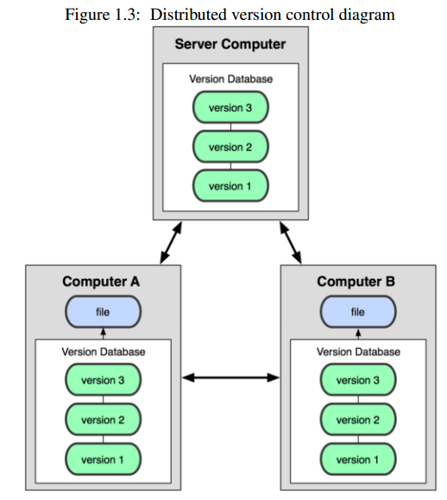
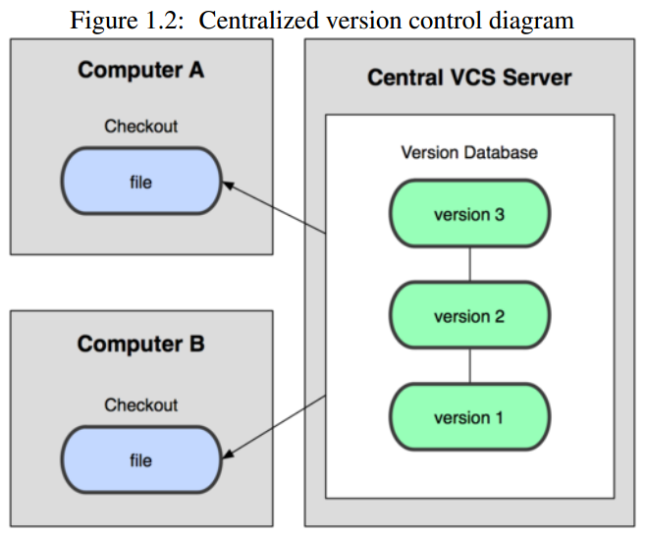
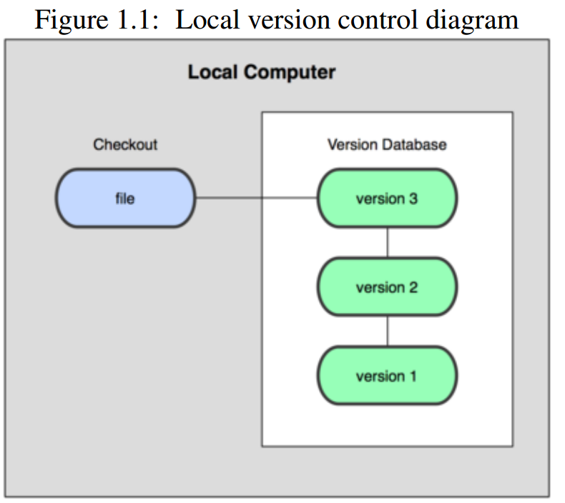
Distributed ?
1.Local
2.Centralize
3.Distributed

Slide 5
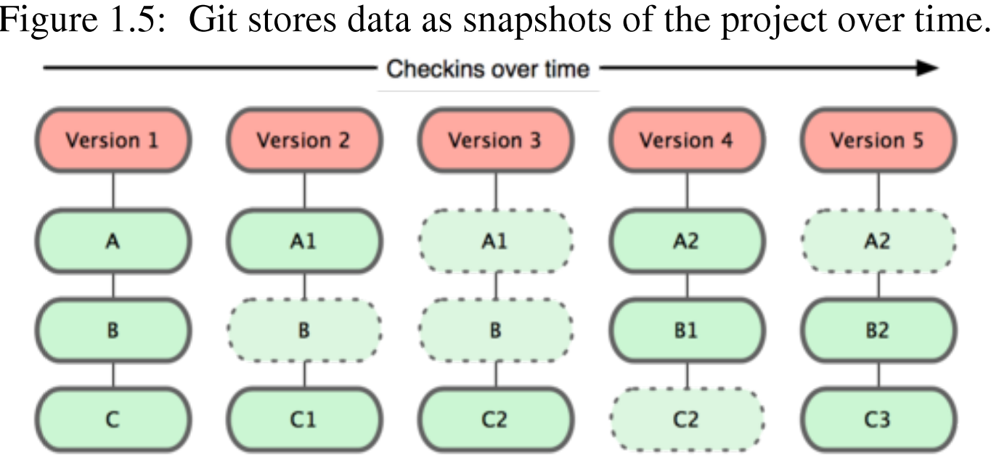
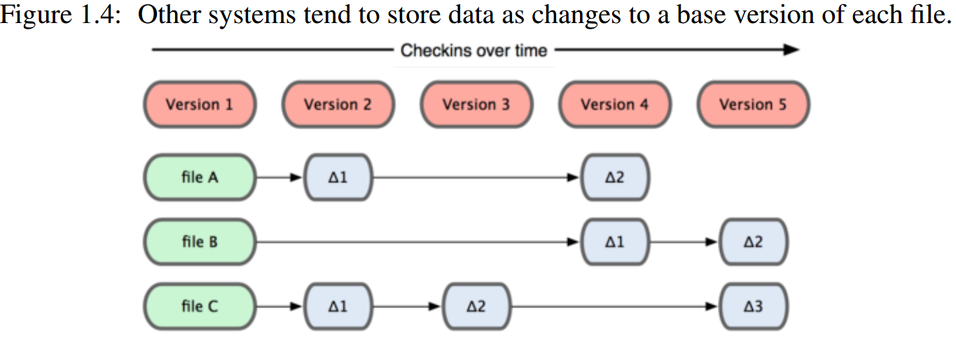
Snapshot, Diff ?

Slide 6

Wow !!!
Can anyone show me How it works ?
please ....

Slide 7
Workflow
Edit -> Visual Studio, Vim, Eclipse, etc.
Inform Mr.Git -> add file to snapshot
    git add
Review -> Check your changes
    git status, git diff
Commit -> Commit to a branch
    git commit
Sync -> Sync your local repository with some share
  center or peer-to-peer repository
    git push

Slide 8
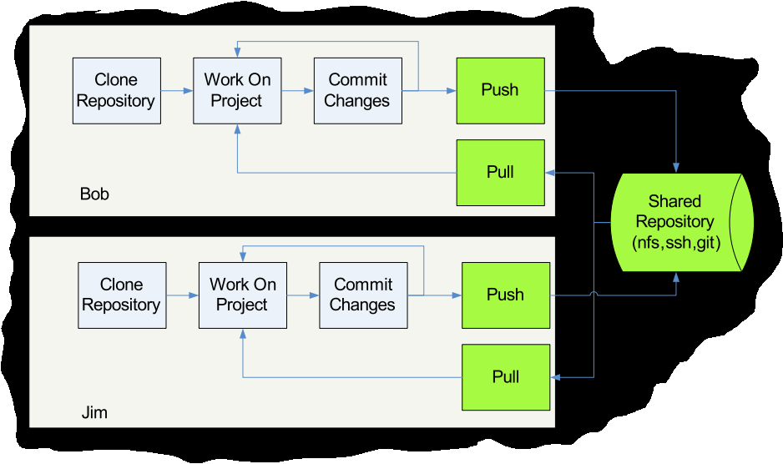
Workflow

Slide 9
Git commands
Getting a Repository
  git init
  git clone
Commits
  git add
  git commit
Getting information
  git help
  git status
  git diff
  git log
  git show

Slide 10
Our First Git Repository
mkdir first-git-repo
cd first-git-repo
git init
  Creates the basic artifacts in the .git directory
echo “Hello World” > hello.txt
  git status
  Show each file status
    Untracked
    New file
    Deleted
    Modified / Modified

Slide 11
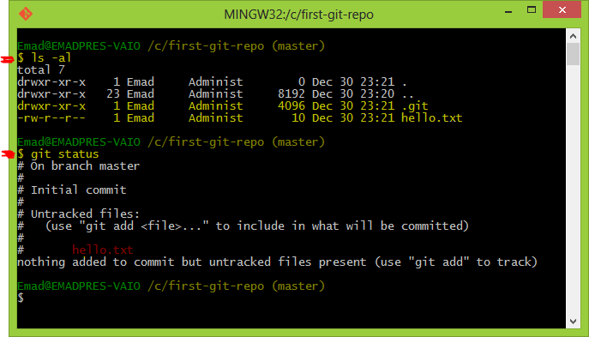
Our First Git Repository (Continue)

Slide 12
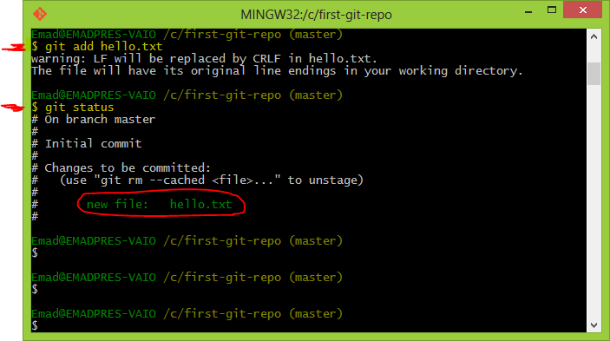
Our First Git Repository (Continue)
git add .
  Adds content to the index
  Index reflects the working version
  Must be run prior to a commit

Slide 13
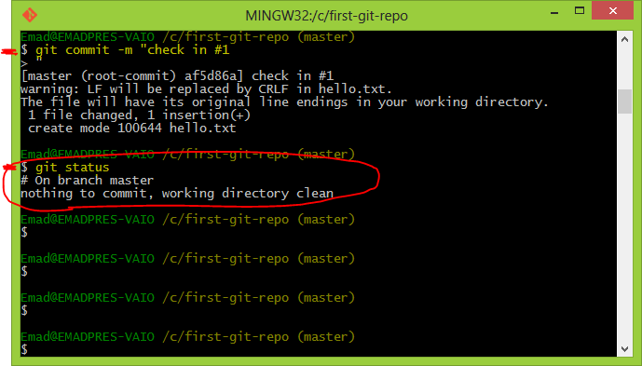
Our First Git Repository (Continue)
git commit -m ‘Check in number one’

Slide 14
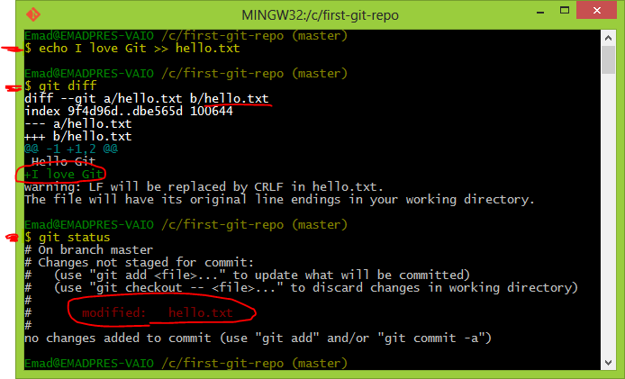
Our First Git Repository (Continue)
echo “I love Git” >> hello.txt
git diff
  Shows changes we have made
git status
  Shows list of modified files

Slide 15
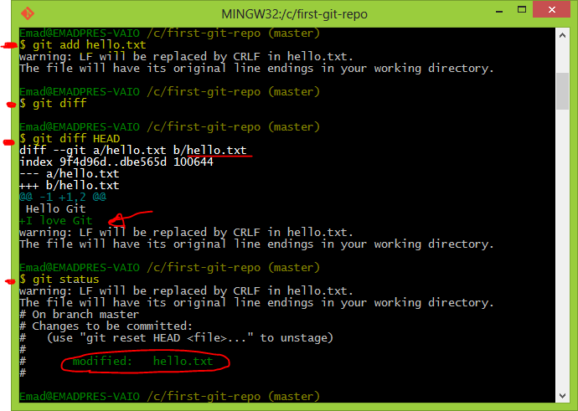
Our First Git Repository (Continue)
git add hello.txt
git diff
  No changes shown as diff compares to the index
git diff HEAD
  Now can see the changes in working version
git status
git commit -m ‘Second commit’

Slide 16
Undoing What is Done
git checkout
  Used to checkout a specific version/branch of the tree
git reset
  Moves the tree back to a certain specified version
  Use the --force to ignore working changes
git revert
  Reverts a commit
  Does not delete the commit object, just applies a patch
  Reverts can themselves be reverted!
Git never deletes a commit object
  It is very hard to shoot yourself in the foot!

Slide 17
Undoing What is Done :: Example
Day1:
  Assume you change a file. To discard these changes to latest commit:
    git checkout -- <filename>
Day2:
  Assume you add the file with ‘git add <filename>’. To discard …
    git reset HEAD <filename>
    [Day1]
Day3: (advanced)
    git reset --hard <commit-hash-value>

Slide 18
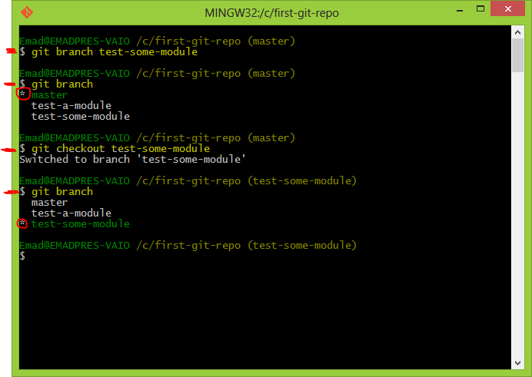
Branching
git branch <new-branch-name>
  Used to create new branch
git branch
  Show all branches and active one
git checkout <dest-branch-name>
  Switch to that branch ( change working directory)

Slide 19
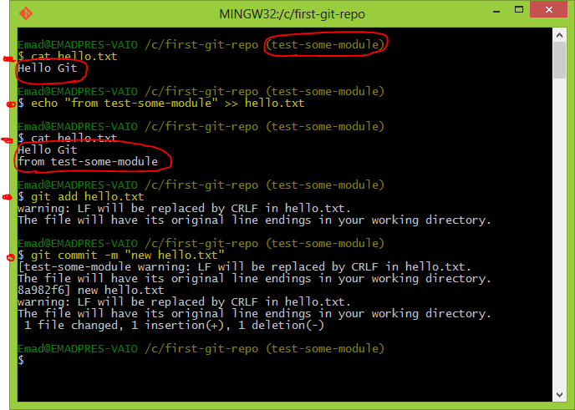
Branching (Continue)

Slide 20
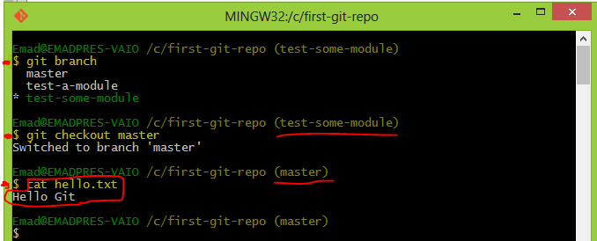
Branching (Continue)

Slide 21
Workflow

Slide 22
Using Remote
Use git clone to replicate repository
  git clone <http://foo.git>
Get changes with
  git fetch (fetches and merges)
  git pull <http://foo.git>
Propagate changes with
  git push <http://foo.git>

Slide 23
http://foo.git ?

Slide 24

Git Extension

Slide 25
Git Extension
What’s It ?
Git Extensions is a toolkit to make working with Git under Windows more intuitive

Slide 26
Git Extension
Install
For VS 2012 ,2010 users:
  it is recommended to install it within Visual Studio by selecting Tools | Extension Manager.
  Run Visual Studio.
  Go to Tools | Extension Manager, search online gallary for Git Source Control Provider and install.
For VS 2008 users :
  download and run Installer for VS 2008

Slide 27
Features
Add support to use Visual Studio's diff window
Prompt user to save files before commit
Prompt user to set name and email for git, if not already
Pending Changes commit not showing hooks errors/messages
Support bulk file deletion
Use new icons for git and git extensions
Allow commit of selected changes via Ctrl+Enter
Automatically save items when refreshing

Slide 28
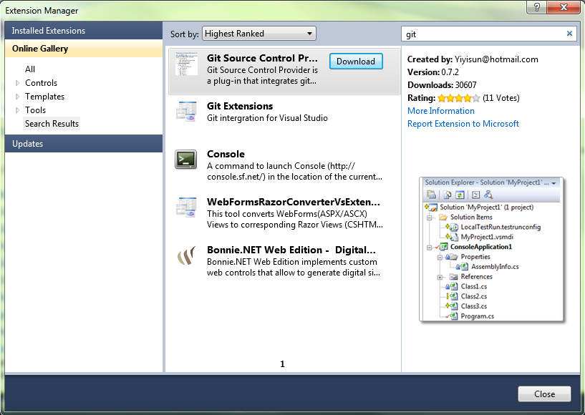
Installing…
Step 1.
Launch Visual Studio, Select menu Tools | Extension Manager,
Search online gallery for Git Source Control Provider .Download and install.

Slide 29
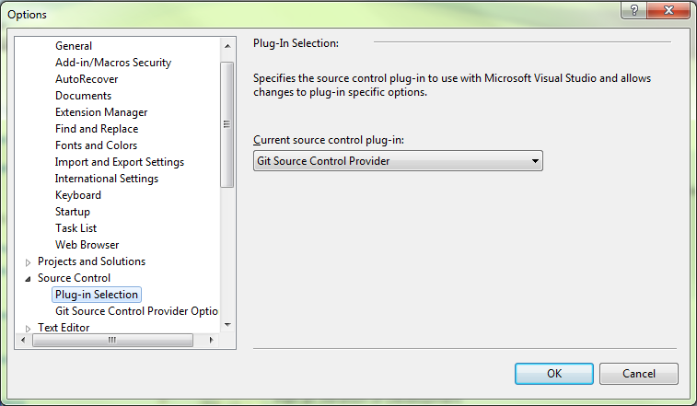
Installing (Continue)
Step 2.
Go to Tools | Options.
Select Source Control in the tree view
Select Git Source Control Provider from the drop down list, and click OK.

Slide 30
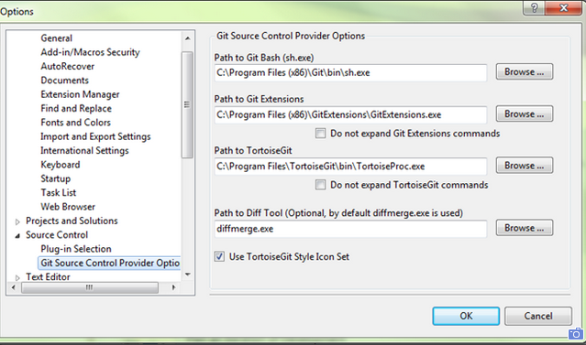
Installing (Continue)
Verify the paths to your favorite Git tools are setup correctly.

Slide 31
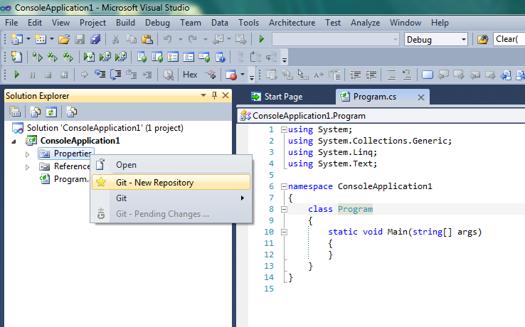
New Repository
To create a new Git repository, right click the project in the solution explorer and select menu:
“ Git - New Repository "

Slide 32
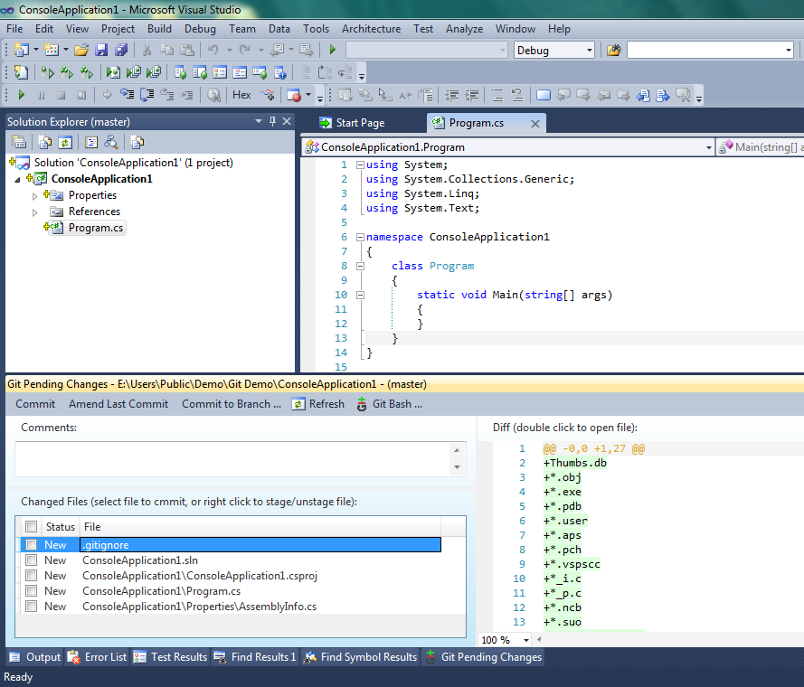
New Repository (continue)
The files status are shown as new files.
The .gitignore file is also created automatically.

Slide 33
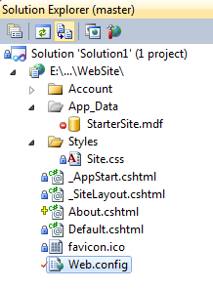
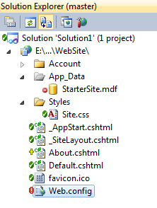
Style
Git Source Control Provider displays file status in Visual Studio's solution explorer. It has two styles, the traditional (VSS/TFS) style and TortoiseGit style.
traditional style TortoisGit style

Slide 34
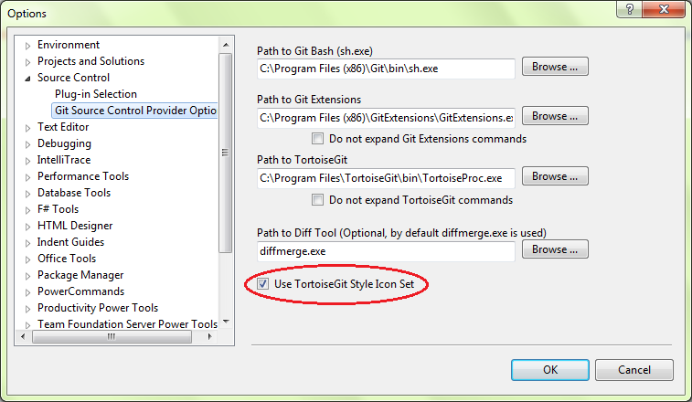
Change style
The the traditional (VSS/TFS) style is the default. By using the Git Source Control Provider options page, under menu Tools | Options, you can choose to use the TortoiseGit style.

Slide 35
So, How to Commits ?

Slide 36
Commit
right click the project in the solution explorer and select menu "Git"
New, modified and deleted files are shown in the Changed Files list.
Select the files you want to commit. The diff view on the right side shows the details of what has been changed compare to last commit.
Add comment message and click the “Commit” button.

Slide 37
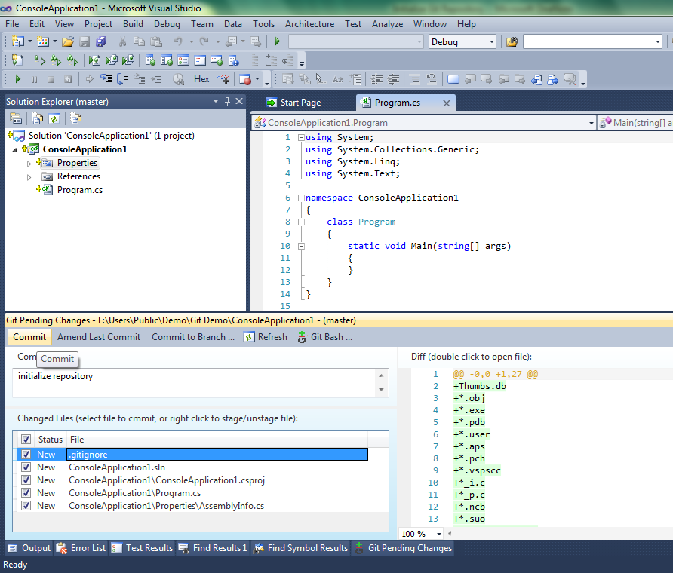
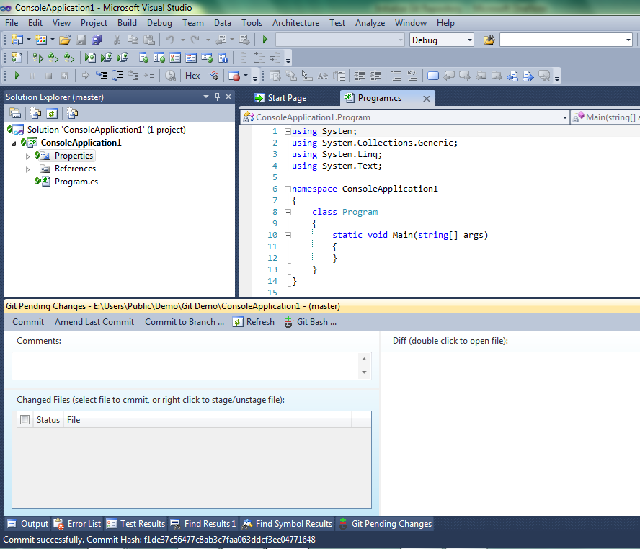
Commit (Continue)
right click the project in the solution explorer and select menu "Git"
New, modified and deleted files are shown in the Changed Files list.
Select the files you want to commit. The diff view on the right side shows the details of what has been changed compare to last commit.
Add comment message and click the “Commit” button.

